Slide 1
A Programmer: encapsulates
Python Programming

Slide 2
Scope (visibility of names)
Module Scope (global)
Names assigned-to outside other scopes
Can be read-from inside functions
Function Scope
Names assigned-to inside functions
Usable after assignment until end of function
If same name as a global, it hides the global
Class Scope

Slide 3
Modifying Global Variables
In Module Scope
myGlobalVar = newValue
In Function Scope
def myFn():
global myGlobalVar
myGlobalVar = newValue

Slide 4
SRP
SRP: Single Responsibility Principle
Each "thing" should only do one thing!
Each package...
Each module...
Each class...
Each function...

Slide 5
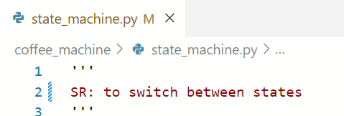
Module
Python's fancy name for a script_file.py
Start file with:

Slide 6
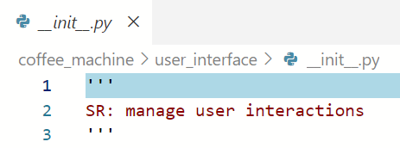
Package
Python's fancy name for a folder
Can document SR in __init__.py

Slide 7
import
Does TWO things
Constructs the contents of the module
and runs any code that is not in a function
Brings the module name into scope
import's don't use .py extension

Slide 8
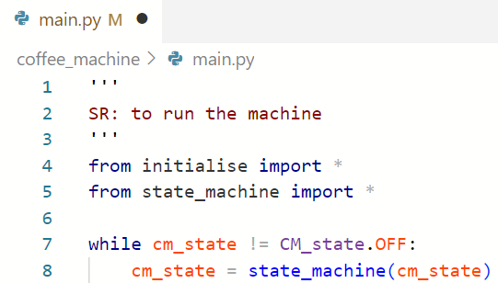
__main__ is NOT a package
The module you "run"
is the "root", not a "Package"
All modules at root are in scope

Slide 9
Names from other Modules
# * imports all names in those modules
from any_root_module import *
from lower_package.some_module import *
In a package below root:
from any_root_module import *
from .sibling_module import * # OK
from ..parent_module import * # Poor design
from ...grandparent_module import * # Worse!

Slide 10
Limited Import
import some_module
# names in some_module need scoping
some_module.niceFn()
from other_module import niceFn
niceFn()
# other names in other_module need scoping
other_module.otherFn()

Slide 11
Private Names
Python doesn't really do privacy!
The best we can do is prefix _
private to module
in a class, private to class
_sort_of_private_name = 1
def _sort_of_private_fn():
pass

Slide 12
help(yourModule)
This doesn't work in VSC terminal!!!
In file-explorer
navigate to your package
Shift-R-Clk->open cmd/powershell
>python
>>>import yourPackage >>>help(yourPackage) (uses __init__.py)
>>>help(yourPackage.yourModule)

